Slide 1







Interfaces, Models, and Monitoring for Resource-aware Transformations that Augment the Lifecycle of Systems (IMMoRTALS)
Matt Gillen (BBN)

Slide 2
Outline
Program Status/Summary (Matt)
Where we are/Accomplishments
IMMoRTALS Basics (Matt)
Challenge Problems, Motivating examples, concept of operation, illustration of the problem/solution space and complexity
Technical Deep Dive (Matt introduces and then hands off)
Summarize current thrusts that we are working on, identify the 1 or 2 that we will deep dive into
Candidates for deep dive (will we have time for all?)
Modeling the ecosystem– why it is important, what have we done, what next (Vanderbilt)
Discovering resource dependency and requirements– why it is important, what have we done, what next (two parts– Syracuse and OSU/Alex)
DAS in action– demo/screenshots (BBN)
Plans for the next quarter (Matt)
Conclusion (Matt)

Slide 3
Program Status
Platform Instantiation
Challenge Problem Definition
Reasonably complete
Vocabulary/Ontology
Environment Model
Ongoing work, initial capabilities developed
Program Analysis
Resource DSL
DAS
CP in DAS
Adaptation/CP Enhancements
Recently Started
We are here
Publications (list them?):
1 presented already
2 accepted
3 in submission
Notes:
Note for the speaker: Stood up the platform, published the two CPs, have a vocabulary to represent the functional and extrafunctional aspects of the program and the ecosystem, have initial capabilities for program analysis to discover resource dependency and usage, DSL for checking, working DAS v1– not pretty looking or with nice interfaces– in process of integrated the upgrades of the components, CP1 working in the DAS v1, CP2 is in process, and also already started looking an enhancements to CPs that will stretch the limits of current analysis and synthesis capabilities. And started publishing..
List of publications

Slide 4
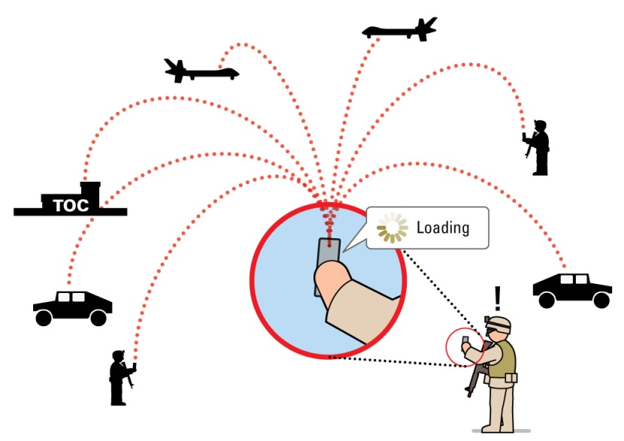
IMMoRTALS Basics (1)
IMMoRTALS Domain/Context: Situation Awareness (SA)
Important and relevant: Situation Awareness (SA) is a key part of modern warfare, law enforcement, humanitarian missions, etc.
Manageable scope: The domain defines the kind of information being processed (i.e., what are SA data) as well as the kind of processing (i.e., sharing, analysis, requesting)
Rich source of diverse and changing use cases and requirements
Notes:
Note to speaker: the domain we picked is important. The domain restricts the kind of functions/functional specification/patterns of usage to a manageable size as compared to general purpose programs– helps us develop techniques to understand and adapt these programs. The domain is also rich enough to offer lots of changes that are needed and meaningful.

Slide 5
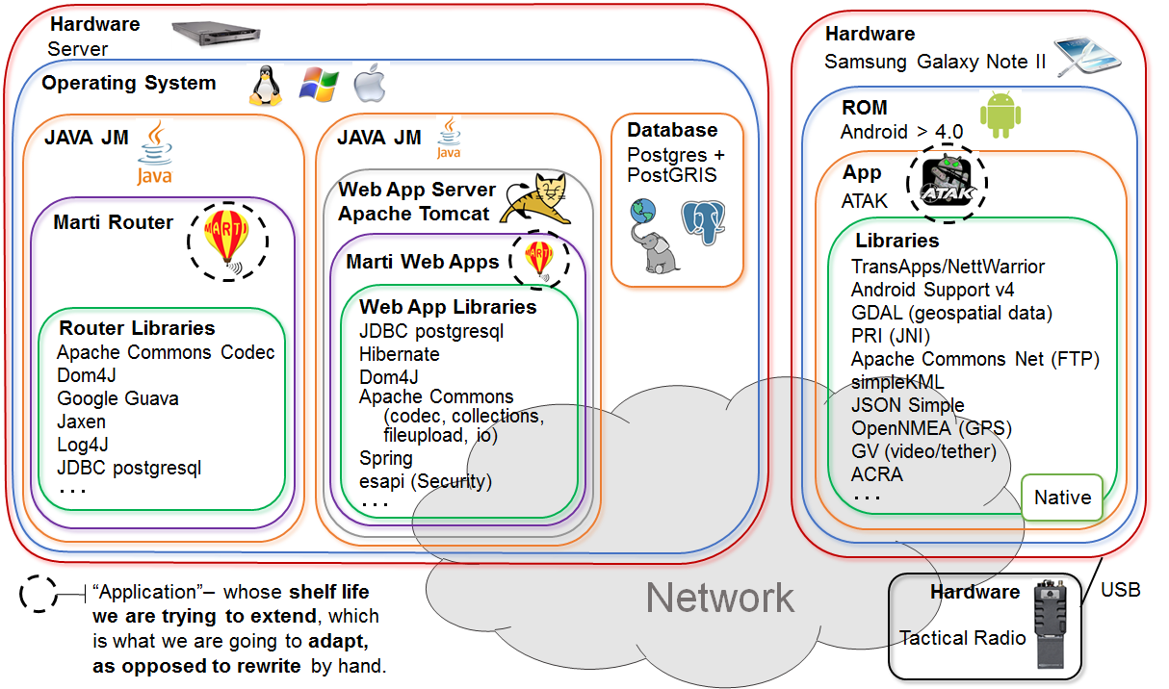
IMMoRTALS Basics (2)
IMMoRTALS Platform: Tactical SA Information Sharing
Right information at the Right time to the Right people - even more important in the tactical situation
Familiarity with the operational use, evolution of requirements
IMMoRTALS Application: there are two
Android client and Java server
Many and changing operating environments→ more opportunity to adapt and evolve
Notes:
Note to speaker: our platform is tactical and info sharing– why is this important and why we chose this, and that ours is probably the unique that the application has two components– client and server, which implies even richer dependencies (e.g, encrypt on one side → decrypt on the other)

Slide 6
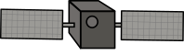



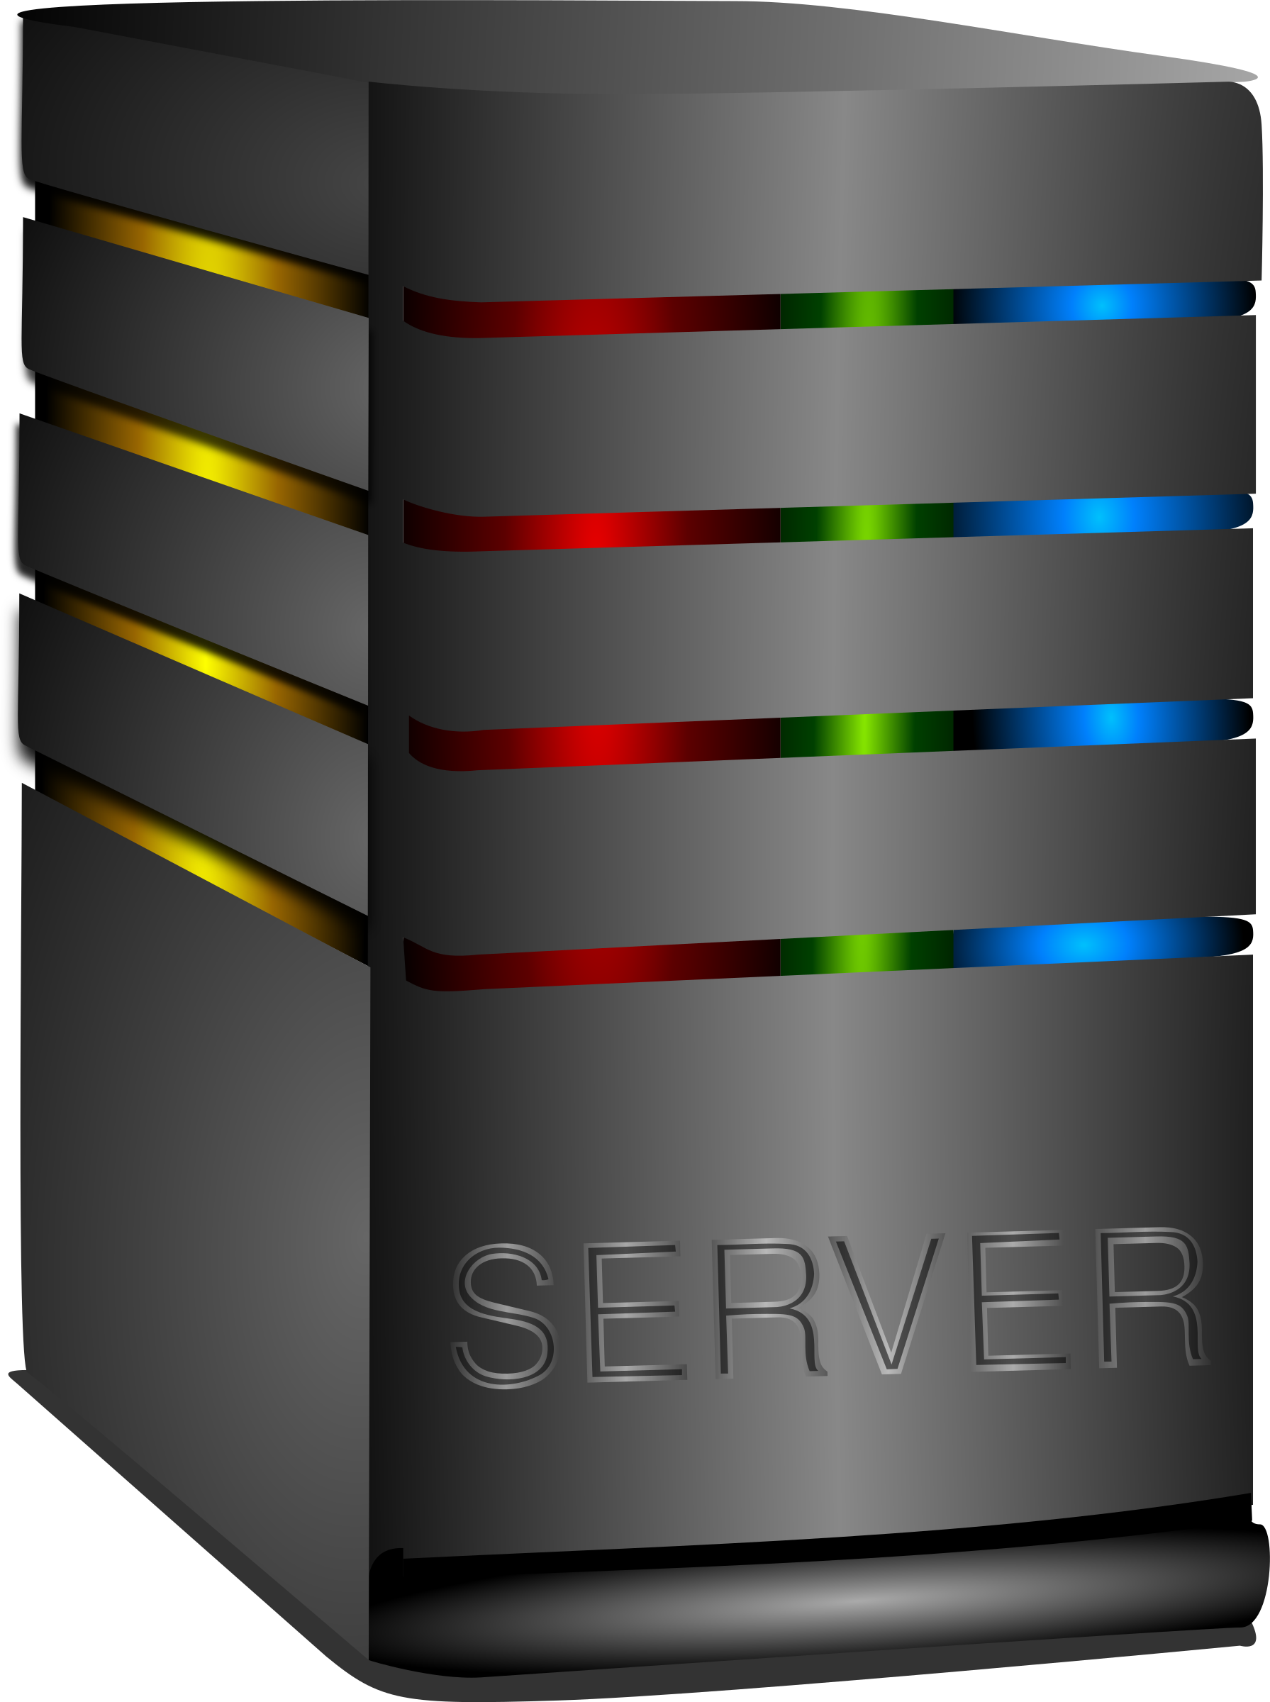



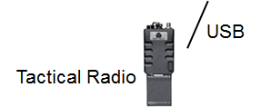



IMMoRTALS Basics (3)
IMMoRTALS Ecosystem: HW and Software resources that the two applications depend on
Traditional shared systems resources (CPU, Memory, Bandwidth), and resources like libraries, hardware devices, external services
And also, the mission where the SA application is engaged (i.e., the mission requirement influence what is important to the application)
Environment
Mission Req
X …
X …
X ...
GPS
Ecosystem
influences
Notes:
Note to speaker: not just the hw and sw environment but also the mission where the app is used is in the ecosystem– they both influence how the apps should be configured, adapted, and how they behave

Slide 7
IMMoRTALS Basics (4)
IMMoRTALS Assumptions
Applications are built as a software product line (well-defined architecture and components)
Functional specification is provided
Extra functional dependency and specification is inferred
Not every line of the application is evolvable, only the point of use of PLA components are
In response to ecosystem changes, IMMoRTALS aims to (make applications):
Adapt: accommodate/respond to change by various means, may not always result in new program versions (e.g., runtime adaptation)
Evolve: results in new versions/variants of application programs

Slide 8
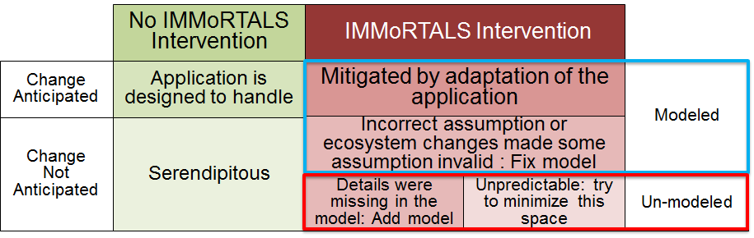
How Does IMMoRTALS Do IT ?
IT: Adapt software to accommodate ecosystem changes
Changes in the operating environment: libraries, hardware, systems resources etc.
Changes in mission requirements
Immortals uses models to represent and reason about functional and extra-functional aspects of software and its ecosystem
Models and changes have an interesting interplay
In addition to adapting the application
IMMoRTALS aims to achieve its goals by
Constructing and analyzing models of applications (functionality and resource dependency and usage) and the ecosystem
Using substitution, elimination and addition of functionality (facilitated by code and behavior modification)
Notes:
Notes for speaker: so how does immortals do it. Lets reiterate what the IT refers to– adapt sw to accommodate ecosystem (both systems env and mission) changes. Immortals relies on models a lot (explain the bottom bullet). There are all kinds of changes, and modeling and changes have an interesting interplay– the figure– explain what we are trying to do

Slide 9
Discrete Functional Units
DFUs are an IMMoRTALS concept that links together functional requirements (Features), code (Implementation) and extra functional specification (Resource dependency and usage)
IMMoRTALS representation of DFUs include
Functional Specifications
Resource consumption
Dependencies
DFU metadata can be discovered automatically (Muse / Droidscope / Mutation Testing), or through explicit programmer annotations
Notes:
Needed a organizing unit that links code and semantic and resource attributes/properties of code…

Slide 10
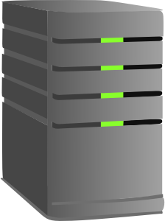

Where Are We: Baseline Application
Designed for < 20 users to share locations
GPS-based, using Android’s internal GPS device+API
No auditing, security requirements
Changes we plan to handle
Systems resource: memory, CPU, bandwidth, available sensors on Android
Software: 3rd part library. OS and remote services
Mission Requirement: No of clients, report rate, image quality, data at rest/transit security, Trust/Accuracy of location, Auditing
Initially we are focusing changes in mission requirements, modeled as qualifiers on functional aspects of the program components.
Notes:
Explain the base line, changes covered etc.

Slide 11
Overview of Phase 1 CPs
CP1: Resource consumption by clients are independent of each other
CP2: Add aggregate resource consumption and dependence
Android Hardware changes
Built in GPS?
Bluetooth?
USB?
Environment changes
GPS satellite visibility
Mission requirements
Hands off?
Trusted GPS needed?
All the variations from CP1
Environment changes
Available bandwidth
Mission requirements
Number of users
Report Rate
Image fidelity
Potential enhancements (mission requirement change)
Auditing (e.g. legal req. to record track history)
Data-at-rest security
Data-in-transit security
Wire-format (e.g. integration with legacy systems, use less efficient wire format)
3rd party library changes
Notes:
Summarize Phase 1 CP, initially all pre-deploymenty. Could cover runtime situations—first triggering offline adaptation(evolution) and deployment of new code, later more online adaptation… CP1 mostly handled by substitution of a DFU/functional aspects, We will go into CP2 in a little bit more details next

Slide 12
CP2 Illustration: The Problem
Has animation….
New mission (e.g., a major event): large number of clients
(and/or the environment has a thinner pipe)
We are deploying for this new mission, give me an application that works
OR
Baseline deployment: less than 20 clients
Oops! Deployed the baseline to this new mission and it does not work!
The baseline application needs to adapt:
Mission requirement: clients still need to share SA data (“intent preservation”)
Congested resource (bandwidth) is getting in the way
Challenges in responding to this kind of changes
Identify constrained / oversubscribed resources
Identify parts of the application that are affected
Find adaptations that might be added to relieve the constrained resources
Notes:
Here, we digress a bit from what we are– to present the inner works and complexities that we are dealing with. The change request can come before we deploy for the new mission, or we may realize that the baseline application does not work after we deployed then in large number in the new mission, which triggered an emergency change request to the developers

Slide 13
High Level End-to-End Walkthrough
What is given:
Functional aspects: which function is sending location data, and where is this function called in the application
PLA/Product Configuration: e.g., each clients sends location data once per second
Change description
Step 2 (reasoning, given change desc.):
Resource check the baseline in new environment: Network bandwidth is the congested resource
100s of clients, 1 send per sec, x bytes per send ←→ available bandwidth (typed DSL)
Step 3 (look for mitigation):
Send less frequently? (reasoning about mission requirement and product spec)
Send less per send, e.g., by new DFU (SemWeb + DSL, works now)
Find ways to reduce what is sent, e.g., assume raw material/code to compress exists (SemWeb+ Synthesis + DSL, under development)
E.g., create a new version of the application whose send location data function compresses before sending
Need to inform receiver to un-compress (for this instance, it happens to be the same client application
Step 1 (prepare to reason):
Ingestion/Bootstrap: Functional and product aspects, ecosystem represented in triple store
Program Analysis: socket writes→ up the call graph → the functions that send location data- in triple store
Program analysis: Estimate of data sent to network per call (based on test data for dynamic analysis)- in triple store
Notes:
Not showing all the details, o all the steps. There will be back and forth. There may be other ways to compose. There are the build and test step, and synthesis will involve adding/amanging other issues like scpe, variable names, impots etc– some of these are issues that we alreadt handle with substitution.

Slide 14
Other variations
SA applications with a fixed report rate might vary in both report rate and number of clients (i.e., the product spec has an acceptable range), both of which have implications for bandwidth usage
Image size affects both bandwidth consumption and CPU consumption– image size may depend on the sensor that produces the image (HW→ bandwidth use dependency)
Scenarios might change rate, number of clients, image size, available bandwidth

Slide 15
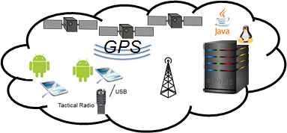

Current State of DAS and Components
Dynamic inputs (ecosystem model)
Configure the environment (test bed)
Environment
Mission Req
X …
X …
X ...
Models
Resource DSL
Discovery
Analysis
Feature Model
SemWeb queries
App Model
Adapted application
f₁ * f₂
(g+h)
x
Static inputs
Permanent Store
DFU Types
Edit, build and test
Code, Partial Annotations
r₁ {...}
r₂ {...}
@dfu
...
@dfu
r₁ {...}
r₂ {...}
@dfu
...
@dfu
r₁ {...}
r₂ {...}
@dfu
...
@dfu
The environment & mission influence the shape and configuration of the constructed system
Notes:
Here we show how things we said in the last slide tie together and also get back to where we are. Shapes are artifacts, gears are processes. Think of the gears are different parts of the DAS working, which parts take what input and produces what. Lots of moving parts and features, we will not summarize most, but do a deeper dive into the encircled parts.

Slide 16
Plan for the Next Few Slides
Models, ability to represent the models in a machine consumable form
Extraction
Functional and product spec-- given
Resource spec– inferred by program analysis
Ecosystem- using modeling tools
Representation
Triple store/Vocabulary
Reasoning about the application, new resource situation and mission requirement
DAS and TA4 Interface
Notes:
Given the baseline product, what is needed to reason about the application’s resource usage, resources provided by the environment and mission requirements: obviously the models of the app and ecosystem, ability to represent them
Outline for the next sections

Slide 17
Current State of DAS and Components
Dynamic inputs (ecosystem model)
Configure the environment (test bed)
Environment
Mission Req
X …
X …
X ...
Models
Resource DSL
Discovery
Analysis
Feature Model
SemWeb queries
App Model
Adapted application
f₁ * f₂
(g+h)
x
Static inputs
Permanent Store
DFU Types
Edit, build and test
Code, Partial Annotations
r₁ {...}
r₂ {...}
@dfu
...
@dfu
r₁ {...}
r₂ {...}
@dfu
...
@dfu
r₁ {...}
r₂ {...}
@dfu
...
@dfu
The environment & mission influence the shape and configuration of the constructed system
Notes:
Here we show how things we said in the last slide tie together and also get back to where we are. Shapes are artifacts, gears are processes. Think of the gears are different parts of the DAS working, which parts take what input and produces what. Lots of moving parts and features, we will not summarize most, but do a deeper dive into the encircled parts.

Slide 18
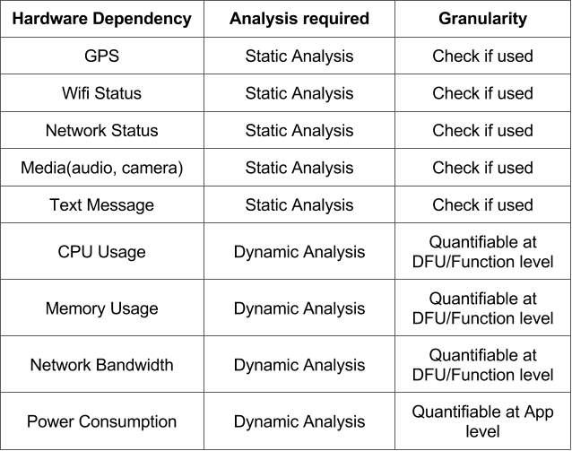
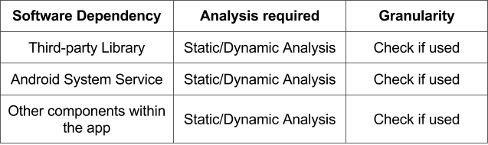
Resource Usage Analysis
Resource usage analysis is essential for annotation generation and later steps.
Hardware Dependency: check if the application relies on certain hardware to function properly and try to quantify some resource usages
Software Dependency: dynamic analysis is needed to resolve some information such as INTENT

Slide 19
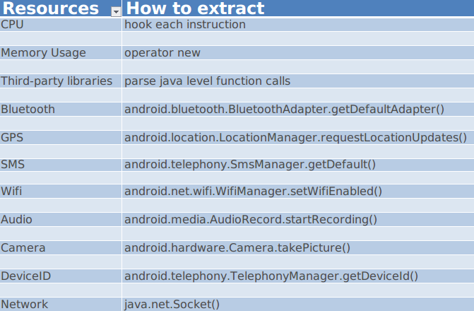
Resource Usage Analysis
Static analysis
Identify Important APIs as indicators of resource
Infer the usage by second-order analysis. For example, requestLocationUpdate() is the API for location request.
requestLocationUpdate() + domain kownledge = GPS satellite usage
Dynamic analysis
Run the application and pinpoint the hooking points for information extraction

Slide 20
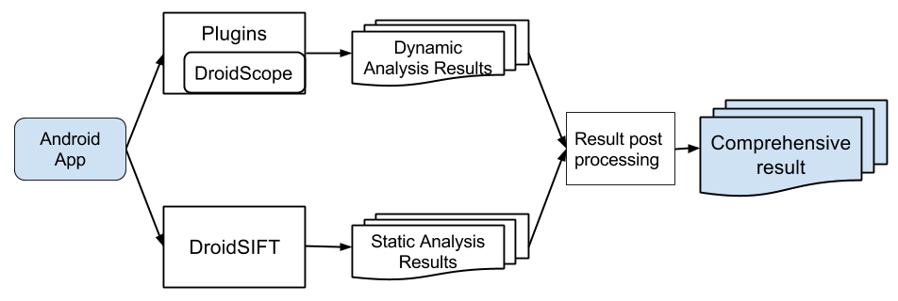
Resource Usage Analysis
Whole system consists of two major components
DroidSIFT: perform static analysis including call-graph analylsis and data dependency analysis
DroidScope: develop plugins on top of the emulation tool and execute the app to collect resource usage information

Slide 21
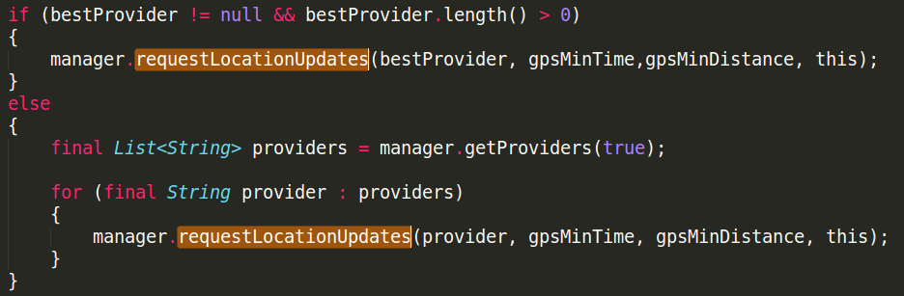
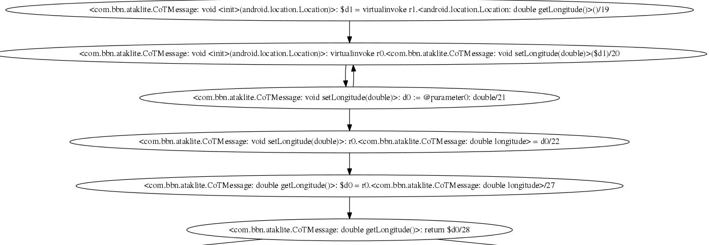
Resource Usage Analysis
Statically identify certain APIs as indicators of resource usage.
Perform data flow analysis to keep track of the data usage.

Slide 22
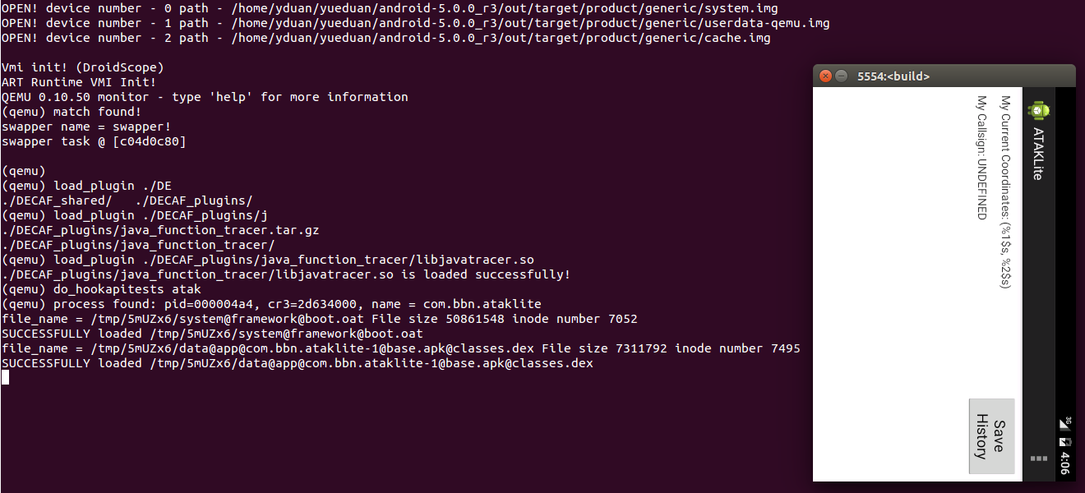
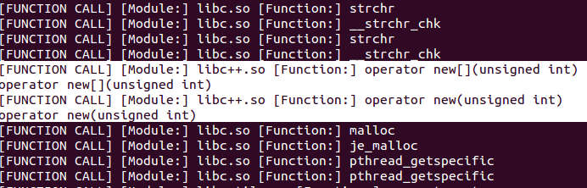
Resource Usage Analysis
Dynamically run the application in Droidscope which is based on Qemu.
Identify various of important hooking points and extract useful information.

Slide 23
Resource Usage Analysis
Summary:
We built tools and a series of plugins on top of DroidSIFT and Droidscope.
We listed important APIs as indicators of resource usage and critical hooking points for information extraction.
We performed call-graph analysis and data-flow analysis to locate important APIs statically.
We executed the application in an emulated environment to extract runtime information.
We processed the analysis results and generated resource profiles for annotation generation and later steps.

Slide 24
Resource Usage Analysis
Future work:
Input dependency analysis:
Resource usage of a program may be dependent on its input (size, type, etc)
For example, an image processing app's resource profile can be heavily affected by the size of given image.
We would like to infer:
existence of input dependency (resource usage is actually dependent on input)
how the input can affect the resource usage
Server program analysis (non-Android program)
Apply similar resource usage analysis on non-Android programs such as server programs

Slide 25
Current State of DAS and Components
Dynamic inputs (ecosystem model)
Configure the environment (test bed)
Environment
Mission Req
X …
X …
X ...
Models
Resource DSL
Discovery
Analysis
Feature Model
SemWeb queries
App Model
Adapted application
f₁ * f₂
(g+h)
x
Static inputs
Permanent Store
DFU Types
Edit, build and test
Code, Partial Annotations
r₁ {...}
r₂ {...}
@dfu
...
@dfu
r₁ {...}
r₂ {...}
@dfu
...
@dfu
r₁ {...}
r₂ {...}
@dfu
...
@dfu
The environment & mission influence the shape and configuration of the constructed system
Notes:
Here we show how things we said in the last slide tie together and also get back to where we are. Shapes are artifacts, gears are processes. Think of the gears are different parts of the DAS working, which parts take what input and produces what. Lots of moving parts and features, we will not summarize most, but do a deeper dive into the encircled parts.

Slide 26

Modeling the Ecosystem
What is the ecosystem?
Why is the ecosystem important?
What have we done to model the ecosystem?
What next?
Adaptation demands originate from the ecosystem
Notes:
Modelling the ecosystem
What is the ecosystem?
Why is the ecosystem important?
What have we done to model the ecosystem?
What next?

Slide 27
Modeling the Ecosystem
What is the ecosystem?
Why is the ecosystem important?
What have we done to model the ecosystem?
What next?
Dynamic inputs (ecosystem model)
Environment
Mission Req
X …
X …
X ...
The ecosystem is everything that impinges upon the constructed system
Notes:
Modelling the ecosystem
What is the ecosystem?
The ecosystem consists of the environment & the mission goals & objectives.

Slide 28
Modeling the Ecosystem
What is the ecosystem?
Why is the ecosystem important?
What have we done to model the ecosystem?
What next?
Dynamic inputs (ecosystem model)
Environment
Mission Req
X …
X …
X ...
Static inputs
Resource DSL
Discovery
Analysis
Feature Model
App Model
f₁ * f₂
(g+h)
x
Constructed System
Partial Annotations
Permanent Store
DFU Types
r₁ {...}
r₂ {...}
@dfu
...
@dfu
r₁ {...}
r₂ {...}
@dfu
...
@dfu
r₁ {...}
r₂ {...}
@dfu
...
@dfu
The ecosystem & application model prescribe & specify the constructed system
Notes:
Modelling the ecosystem
Why is the ecosystem important?
The ecosystem is symmetric to the constructed system.
The ecosystem issues a set of challenges to which the constructed system responds.
We generate a set of specifications from the ecosystem models.

Slide 29
Modeling the Ecosystem
What is the ecosystem?
Why is the ecosystem important?
What have we done to model the ecosystem?
What next?
Mission Model
Execution Environment Model
Component Model
Network Connectivity Model
Topic Model
The models interact
Notes:
Modelling the ecosystem
What have we done to model the ecosystem?
The models interact producing complex and emergent behavior.

Slide 30
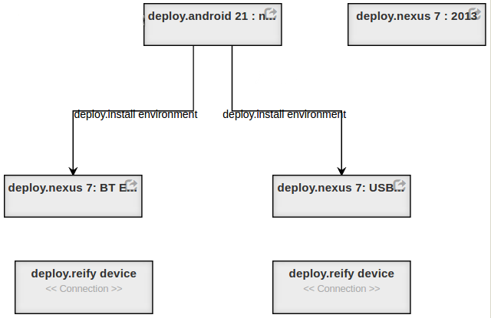
Modeling the Ecosystem
What is the ecosystem?
Why is the ecosystem important?
What have we done to model the ecosystem?
What next?
Execution Environment model
How are packages combined to form execution environments suitable for deployment to devices
The components are combined to form packages for specific purposes.
Notes:
Modelling the ecosystem
What have we done to model the ecosystem?
The Execution Environment Model assembles a set of component DFU’s into a deployable package.

Slide 31
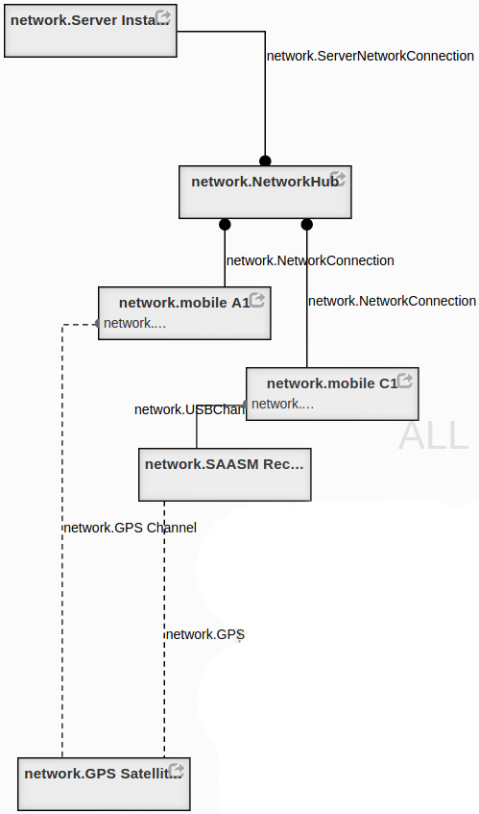
Modeling the Ecosystem
What is the ecosystem?
Why is the ecosystem important?
What have we done to model the ecosystem?
What next?
Network topology model
Along what paths are devices able to communicate?
The network topology model names hardware & their locations
Notes:
Modelling the ecosystem
What have we done to model the ecosystem?
The Network Topology Model describes the intended configuration of specific network devices.

Slide 32
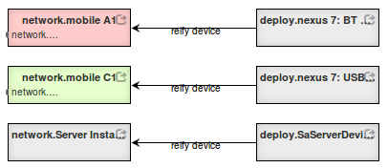
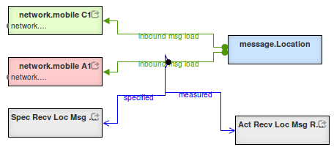
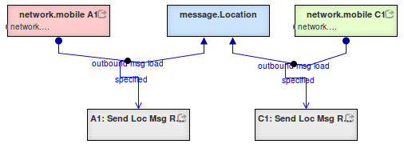
Modeling the Ecosystem
What is the ecosystem?
Why is the ecosystem important?
What have we done to model the ecosystem?
What next?
Mission model
Where do messages originate?
To whom are they directed?
Build a mega-model including cross-cuts
Notes:
Modelling the ecosystem
What have we done to model the ecosystem?
The Mission Model describes the goals for the application in a particular context.

Slide 33
Modeling the Ecosystem
What is the ecosystem?
Why is the ecosystem important?
What have we done to model the ecosystem?
What next?
Generate script to deploy software to specific devices
Formal methods
Type systems (DSL)
Construction following specification
Property-based testing & survey
Run time observation & measurement
Construct logger configuration to record & monitor key metrics
The ecosystem mega-model specifies behavior for the constructed system
Notes:
What next?
We generate a set of specifications from the ecosystem models.
These specifications can be used to verify the constructed system:
By formal methods (other players)
By type-systems (OSU)
By construction according to the model (in-progress )
By property-based testing in simulated environments (Syracuse)
By observation & measurement of fielded system (LL)
Property-based:
https://fsharpforfunandprofit.com/posts/property-based-testing-2/
https://www.youtube.com/watch?v=zi0rHwfiX1Q

Slide 34
Current State of DAS and Components
Dynamic inputs (ecosystem model)
Configure the environment (test bed)
Environment
Mission Req
X …
X …
X ...
Models
Resource DSL
Discovery
Analysis
Feature Model
SemWeb queries
App Model
Adapted application
f₁ * f₂
(g+h)
x
Static inputs
Permanent Store
DFU Types
Edit, build and test
Code, Partial Annotations
r₁ {...}
r₂ {...}
@dfu
...
@dfu
r₁ {...}
r₂ {...}
@dfu
...
@dfu
r₁ {...}
r₂ {...}
@dfu
...
@dfu
The environment & mission influence the shape and configuration of the constructed system
Notes:
Here we show how things we said in the last slide tie together and also get back to where we are. Shapes are artifacts, gears are processes. Think of the gears are different parts of the DAS working, which parts take what input and produces what. Lots of moving parts and features, we will not summarize most, but do a deeper dive into the encircled parts.

Slide 35
Ontology
We model our problem space using a set of linked ontologies
ControlPoints are code regions where functionality equivalent components can be injected
Functional spec is conveyed by adding reusable properties to a core functional abstraction
Contrast with the strategy of explicitly enumerating all possible functionalities
E.g., a lossy compression algorithm for images:
compress : { lossy ^ applicableToDataType(Image) }
Core functionality abstraction
Simple property
Complex property
Property variable

Slide 36
Annotations
Annotations are one mechanism for conveying and storing knowledge about code
Programmer (provides high-level intent)
Static analysis (data flows, design patterns)
Dynamic analysis (resource use, live code behavior)
MUSE (extension of above)
We auto generate annotation-concept bindings that can later be parsed into semantic models
/**
* @param an array of bytes compressed with multi-pass LZMA (LZMA2)
* @return the decompressed data
*/
public @BinaryData byte[] decompress(
@BinaryData
@Compressed(compressionAlgorithm=LZMA2.class)
byte[] data
){

Slide 37
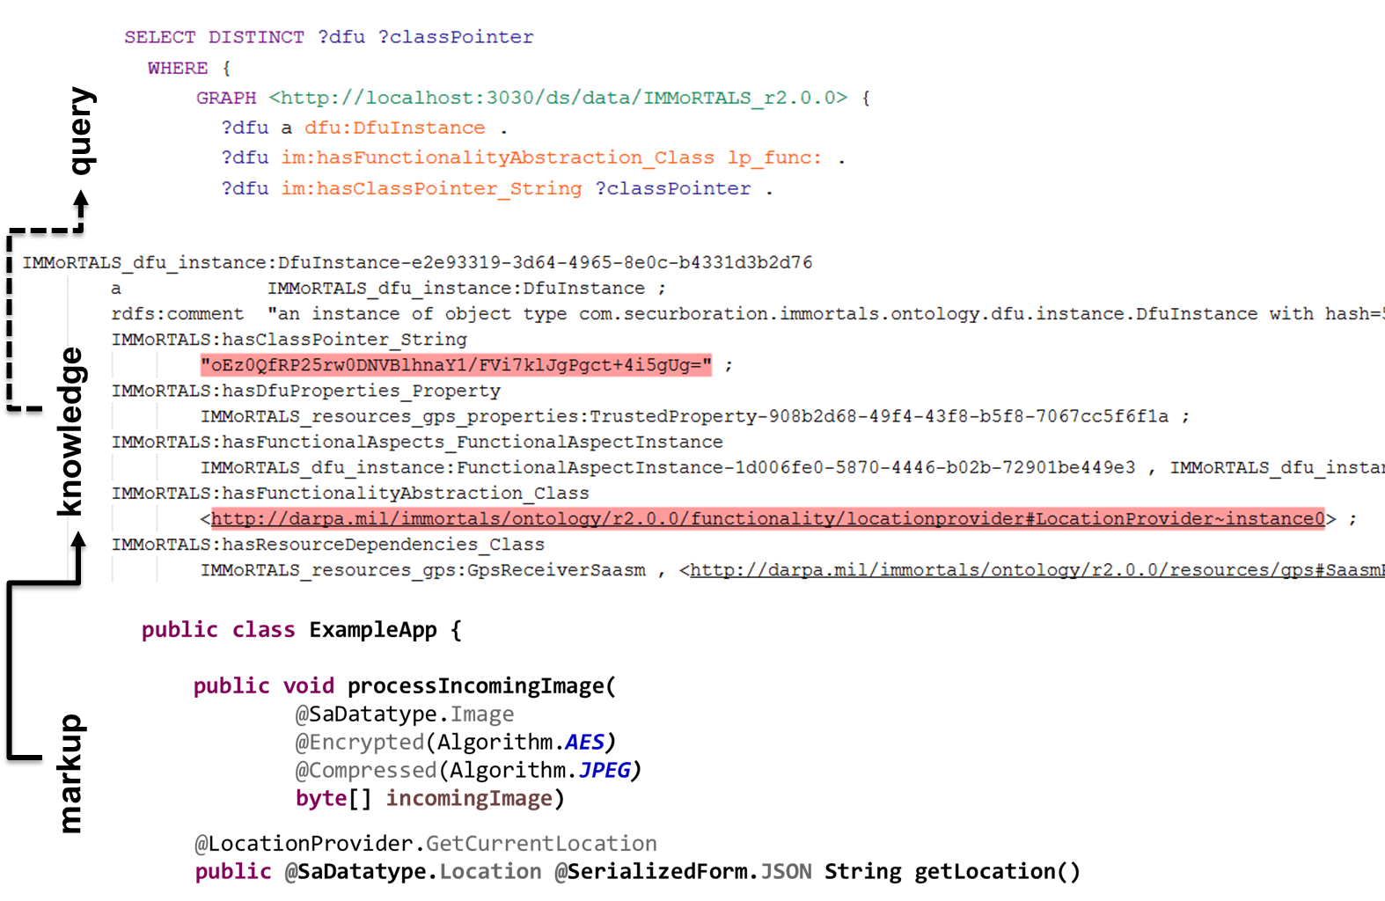
Use case

Slide 38
Current State of DAS and Components
Dynamic inputs (ecosystem model)
Configure the environment (test bed)
Environment
Mission Req
X …
X …
X ...
Models
Resource DSL
Discovery
Analysis
Feature Model
SemWeb queries
App Model
Adapted application
f₁ * f₂
(g+h)
x
Static inputs
Permanent Store
DFU Types
Edit, build and test
Code, Partial Annotations
r₁ {...}
r₂ {...}
@dfu
...
@dfu
r₁ {...}
r₂ {...}
@dfu
...
@dfu
r₁ {...}
r₂ {...}
@dfu
...
@dfu
The environment & mission influence the shape and configuration of the constructed system
Notes:
Here we show how things we said in the last slide tie together and also get back to where we are. Shapes are artifacts, gears are processes. Think of the gears are different parts of the DAS working, which parts take what input and produces what. Lots of moving parts and features, we will not summarize most, but do a deeper dive into the encircled parts.

Slide 39
DAS Workflow
Sent comments on this separately- be careful about so many different types of compose
The next three slides follow the straight path substitute, resource check, build
After that you have “evolve” that includes substitute
And then discovery
That does not really work
Suggest moving discovery by mutation between Syracuse and Vanderbilt
Match Mission Functionality
Look for compose options (functionality)
X …
X …
X ...
No
Yes
Fit Resource Constraints
Look for compose options (resources)
No
Yes
Look for compose options (transforms)
Builds
No
Yes
Runs
Re-profile DFUs or Manual Input (e.g. fix DFU metadata)
No
Yes
Matt to update
Deploy new variant

Slide 40
Matching Mission Functionality
Map mission requirements to properties of functional units
For each type of functionality:
Evaluate if any available DFU implementation for a given type of functionality satisfies all required properties
Build list of compliant DFUs
If we have at least one candidate DFU for each type of functionality, move on to resource constraint checking

Slide 41
Resource specification DSL
Can be used to answer the following questions:
Does an application instance satisfy the deployment model? (Type checking, status: working, incomplete integration)
How to configure the app model to produce a valid instance? (Type inference, status: research in-progress)
What is the best configuration for a deployment model? (Type inference + valuation, status: future)

Slide 42
DSL Example
Other resources unaffected (row poly.)
Needs GPS sig (non consumable)
Provides location data
High-level functional annotation:
LocationProviderAndroidGPS : { !GPSSatSig | r } { !GPSSatSig, !LocData | r }
Resource usage deduced from discovery analysis:
LocationProviderAndroidGPS : { Mem: m@Nat | r } { Mem: [v | v = m – 128] | r }
Needs memory
Dependent variable
Refined
type
Consumes 128 units of memory to run
Combine partial resource types into single resource type for each DFU:
LocationProviderAndroidGPS : { Mem: m@Int, !GPSSatSig | r }
{ Mem: [v | v = m - 128 & v ≥ 0], !GPSSatSig, !LocData | r }
Notes:
These are current thoughts, and may evolve. Shortcomings involve global variables, and what if not all clients get all SA messages (different subscriptions)

Slide 43
DSL Example
Simple application model with variation point:
app = if check SAASM
then load LocationProviderSaasmGPS
else load LocationProviderAndroidGPS
Parameterized application model with server and n clients:
app = λ n.
s ← load server
cs ← repeat n (load client)
return (s, cs)
Monadic style:
– resource constraints are checked and propagated in the background
– resulting application must satisfy the deployment model (description of required services + constraints on resource environment)

Slide 44
Build and Test/Run
(TODO: some details about how program synthesis is going to work)
If build succeeds, run through validation tests
Deploy
Matt to update

Slide 45
Going Beyond Substitution
Based on resource availability and mission requirements, the DAS may substitute a DFU
But the replacement DFU may not be available
Transform: extend a function with existing raw material
Insert: add an adapter or wrapper
Compose and Substitute: compose two DFU classes
Even after substitution, insertions or transformation, the resulting application may not fit available resource
Removal: Leverage discovery via mutation
Attempting to fix the fact that you already have talked about substitution, and you have not talked about control point– suggest avoiding the term
Notes:
Transform: inject compress code into send() so that send now sends compressed data
Insert: insert an adapter– to manage argument mismatch for example

Slide 46
Composing DFUs
Compose functional aspect: e.g. Explicit Mission requirement for data-at-rest encryption leads to implied requirement that the TrackLogger DFU must have “encrypted” property.
Need to compose a Crypto DFU with TrackLogger DFU implementations to satisfy mission requirements.
Compose resource aspect: compression of various forms trade off one resource for another
Compose data-types: combine individuals into a structure (or class)
e.g. (double lat, double lon) -> coordinate structure
Cleaned up

Slide 47
Composing DFUs Challenges
Move to next steps? Do not use jargons like application model etc
Invertible?
Encryption and some kinds of compression need to be inverted (e.g. if you encrypt on the ‘write’ of some data, you need to decrypt on the ‘read’ of that same data).
Our application model will tell the DAS that two points in the application are linked, but challenges remain.
Ordering
The end result of encrypt(compress(byte[])) is very different from compress(encrypt(byte[])), which affects resource consumption.

Slide 48
Discovery via Mutation: Overview
Move after SYR
Relying exclusively on annotations/DFU-based approach limits ability to discover non-critical resource uses in legacy or other non-annotated code
Solution: use the test suite to automatically identify non-critical functionality, map removal units to reclaimable resources
Mutate program P to program P’ that also passes test suite T
P’ has less code, but still passes all tests
Static and dynamic analysis used to split P-P’ into units and map those units to reclaimable resources
P
JavaReducer: Mutation + Delta Debugger
P’
T
T
Dynamic Analysis Traces: D
Dynamic Analysis Traces: D’
Static Analysis Result: S
Static Analysis Result: S’
Diff S-S’ D-D’
Resource Uses

Slide 49
Discovery via Mutation: Producing P’
Move after SYR
Hierarchical delta debugging begins from bottom-up to remove code
Much larger removal units than traditional mutation testing
Looking for mutants that cannot be detected by test suite
Start removal at leaves of AST, move up
Resource uses: R1, R2, R3, R4, R5
Example:
Remove calls to system logger first
Remove initialization of system logger once all calls are gone
Result: P’ has less writes to SSD, lower memory usage (logging cache gone)
red code is removable
Resource uses: R1, R2, R4’, R5’ (R3 gone, R4/5 lower)

Slide 50
Next Steps
Continue to evolve
Automate gathering of Application model
Work backward from DFUs in baseline application
Matt to update

Slide 51
IMMoRTALS (Tactical SA) Platform
IMMoRTALS code base, build and test environment
Error report, deploy/update SW
IMMoRTALS Management Network
Host
Ecosystem
SA producer & consumer
Brokering and Storage
IMMoRTALS back end
Operational Network
Server Host
Android
Ecosystem
Ecosystem
Deployed/running platform application
Android Clients
Linux/Java Server
Backend
Change detection tools
Runtime management tools
Program synthesis tools
Build tools
Validation tools
Program analysis tools
Repo
y

Slide 52
IMMoRTALS Test (TA-4) Interface
System Under Test (SUT)
DAS
(Diagnose, Transform, Build)
SA Client 1
Server
Platform network
SA Client n
2
Application binaries; configurations
5
Deploy Platform applications
1
Log Data
Test Scripts
3
Logging Service
Perturb SUT
(REST CALL)
4
6
7
Status (JSON)
Begin platform execution
Analyze Auxiliary data
Analyze Logs
Lincoln Test Harness

Slide 53
Conclusion
Making good progress
Platform, CP1
Whole system analysis, Mutation
Code evolution primitives- substitute, transform, compose, insert, remove
Started publishing
Lots of hard challenges next
Evolution primitives with invertible complement
Evolution primitives with ordering
Handling compilation and build errors
This is weak, needs to update

